Slide 1

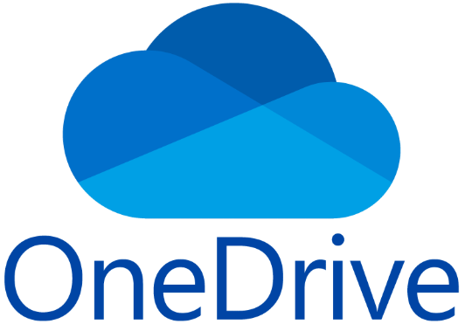
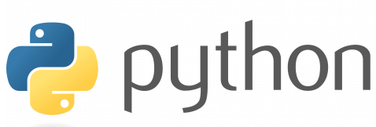
Debranding of Diamond Drilling Documents

Slide 2
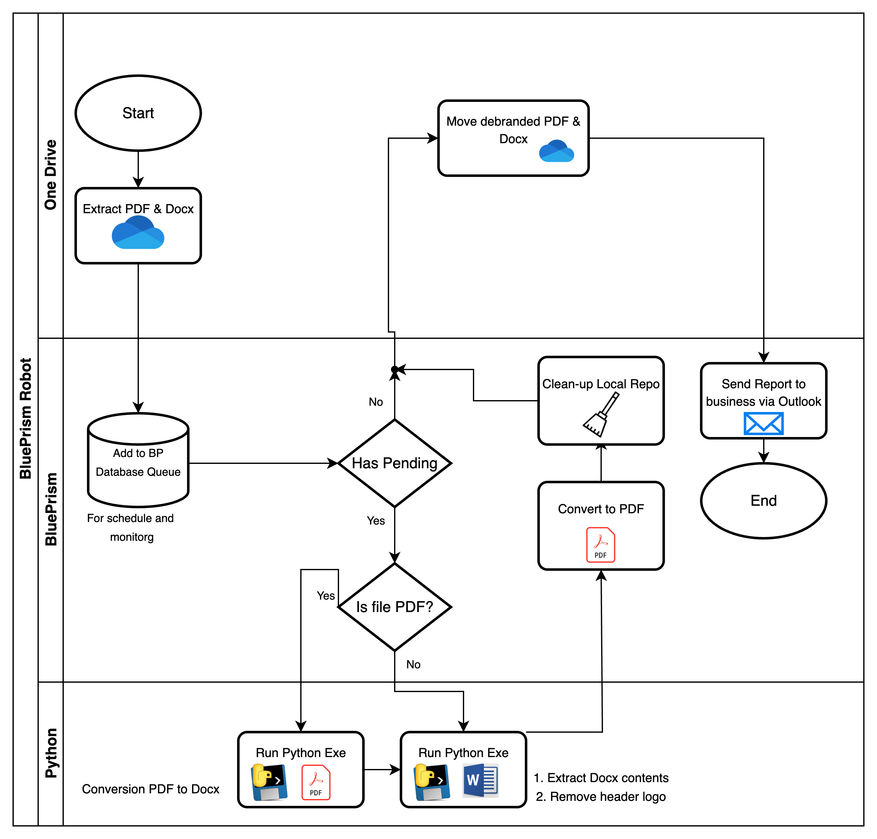
Process Flow

Slide 3
The problem & idea
In 2024, the company I am working with acquired Diamond Drilling, leading to 1,000-2,000 legal documents requiring removal of logo for oil rigs. With no plans to hire additional staff, the focus is on fast, accurate, and cost-effective completion of the project.
The idea is to create a robot that can run in multiple servers for quicker completion. It should also be cost effective, that means the technology to be used should be free of use, and the deployment to production should be immediate as the project is connected to legal side of the company.

Slide 4
The solution & output
I developed a Blue Prism robot with supervised OneDrive access for multi-server deployment and monitoring. This solution integrates Python executables (one for DOCX logo replacement, adapted from a 2023 handover script, and another I created for PDF to DOCX conversion due to Blue Prism's limitations) to automate file movement, removing of logo in DOCX file, and DOCX to PDF conversion. The initial run yielded a 98% clean PDF file rate, with 500 documents processed.

Slide 5
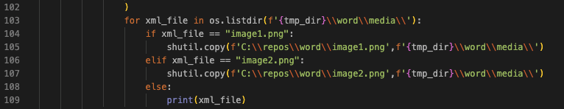
How it did i
I modified an existing Python script, and packaged it in main_modified_backup.exe. The logic from line 103 is to extract DOCX content to a temporary location and replace header logos (image1.png or image2.png) with a new, identically named PNG. This was implemented with a simple for-loop and if-else condition to ensure ease of understanding for other developers during handover.

Slide 6
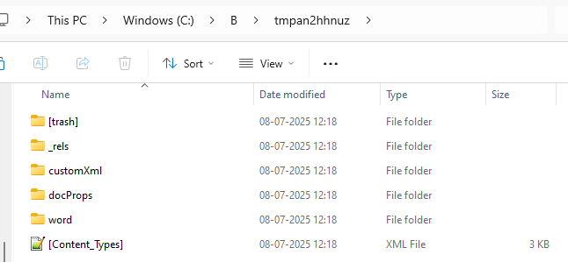
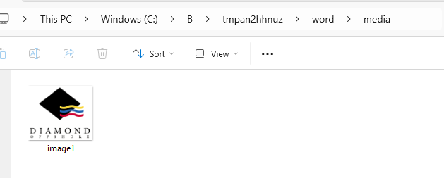
How it works: Core task
Here a temporary path is created where it stored the extracted XML, HTML, and images from the docx file. In the \\word\\media\\ path is where I found the logo document.

Slide 7
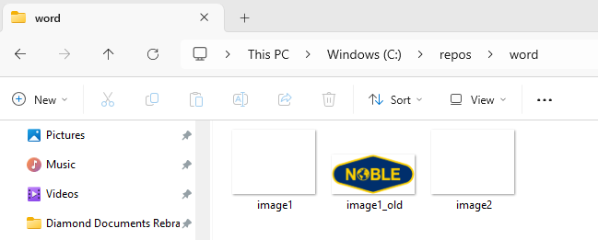
How it works: Core task
I used shutil.copy to replace image1.png in the temporary DOCX extraction path with a local version, it ensured the proper re-compilation without template issues.
On the previous project (rebranding) I also used this concept wherein the image1.png from local is another logo (Noble Corp logo) to replace the existing (Maersk Drilling logo) in the document.
This method serves as an effective workaround for the current project's rebranding needs, though it is not a universal solution.

Slide 8
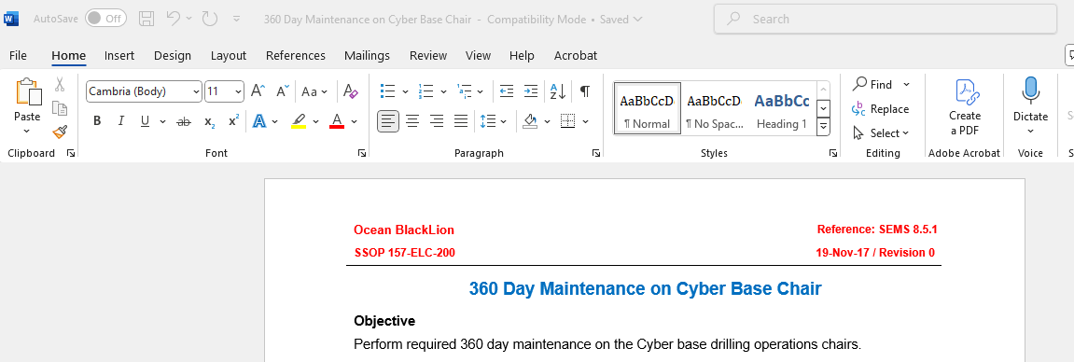
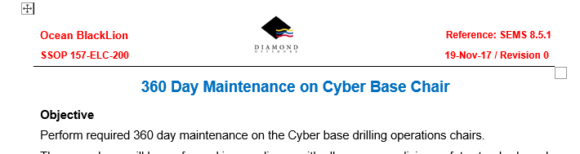
How it works: Core task
The solution successfully removes the logo from DOCX files during PDF conversion, preserving data integrity and document alignment.

Slide 9
Learnings & Conclusion
This project served as a significant test of my resourcefulness and adaptability under tight deadlines. Tasked with a critical component of the solution, I learned an existing Python script just two months on top of my automation dev tasks before project initiation. My immediate challenge was to rapidly breakdown its existing logic, understand its underlying functionality, and then strategically modify it for a highly specific use case within the project's scope. This requires not only strong analytical skills but also the creativity to leverage it’s core capabilities to meet the project requirements.
This engagement provided an invaluable opportunity to put my knowledge of system integration into practice. It reinforced my understanding of how Python, a versatile programming language, can dramatically extend the capabilities of Robotic Process Automation (RPA) tools like Blue Prism. While Blue Prism excels in process orchestration and UI automation, integrating custom Python executables allowed us to tackle complex tasks – such as advanced document manipulation (e.g., precise logo replacement and robust PDF-to-DOCX conversion) – that would otherwise be challenging or impossible with Blue Prism's native functionalities alone. This strategic combination of tools truly widened the scope and power of our RPA robots.
Ultimately, this project marked a significant milestone for the team. It was the first initiative to showcase our capability to innovate beyond the confines of a single RPA platform like Blue Prism. By integrating external programming tools, we proved our agility and forward-thinking approach, opening new avenues for complex automation challenges.

